Slide 1
Web and Internet
The History

Slide 2
Agenda:
Origins of the Internet
Key Internet Technologies
Evolution of the World Wide Web (WWW)

Slide 3
Before Internet
Before the invention of the internet, data transfer primarily took place through various other mean.
Postal Mail
Telegraph
Telephone
Fax Machines
Telex
Radio and Television Broadcasting

Slide 4
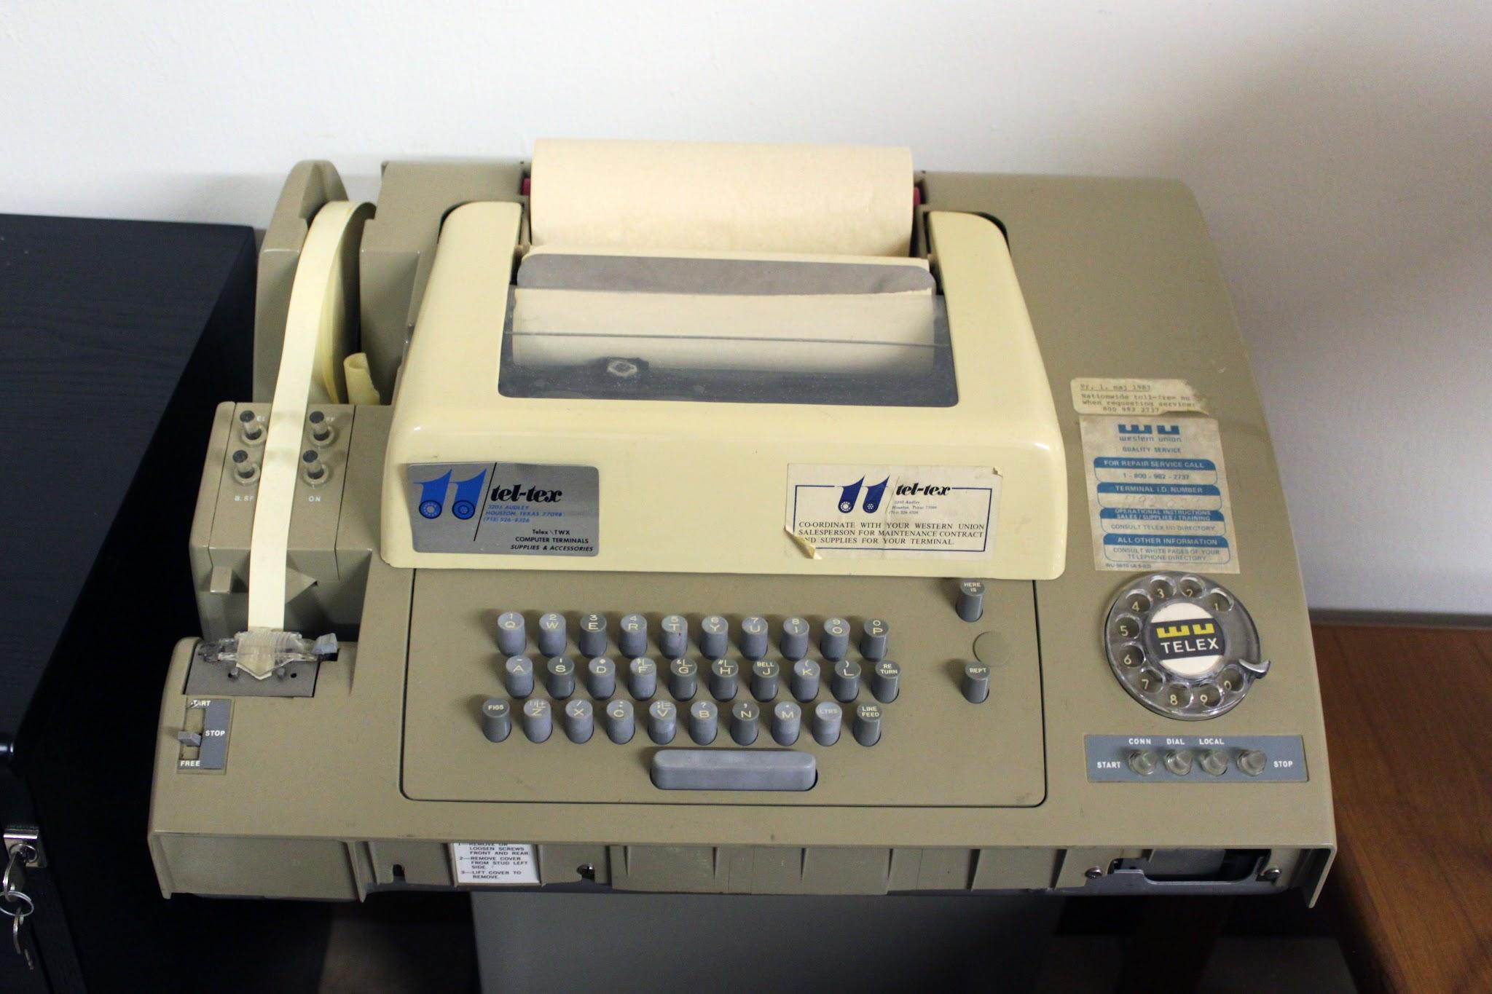

Slide 5

Definition of the Internet:
The Internet is a global network of interconnected computers that enables communication and the sharing of information.

Slide 6
Origins of the Internet
The Internet's roots can be traced back to the 1960s when the U.S. Department of Defense's Advanced Research Projects Agency (ARPA) created a network called ARPANET.
ARPANET was designed to facilitate communication and data transfer between different research institutions.

Slide 7
Key Internet Technologies:
Transmission Control Protocol (TCP) and Internet Protocol (IP) formed the foundation of the Internet, allowing for reliable data transmission across networks.
Domain Name System (DNS) enabled the use of human-readable domain names instead of numeric IP addresses.

Slide 8
Introduction to the WWW
The World Wide Web, commonly referred to as the Web, is an information space where documents and resources are identified by Uniform Resource Locators (URLs).
It was invented by Sir Tim Berners-Lee in 1989 while working at CERN, the European Organization for Nuclear Research.

Slide 9

Introduction to the WWW
TIM BERNERS-LEE, INVENTOR OF THE WEB, POSES IN FRONT OF THE FIRST WORLD WIDE WEB SERVER

Slide 10
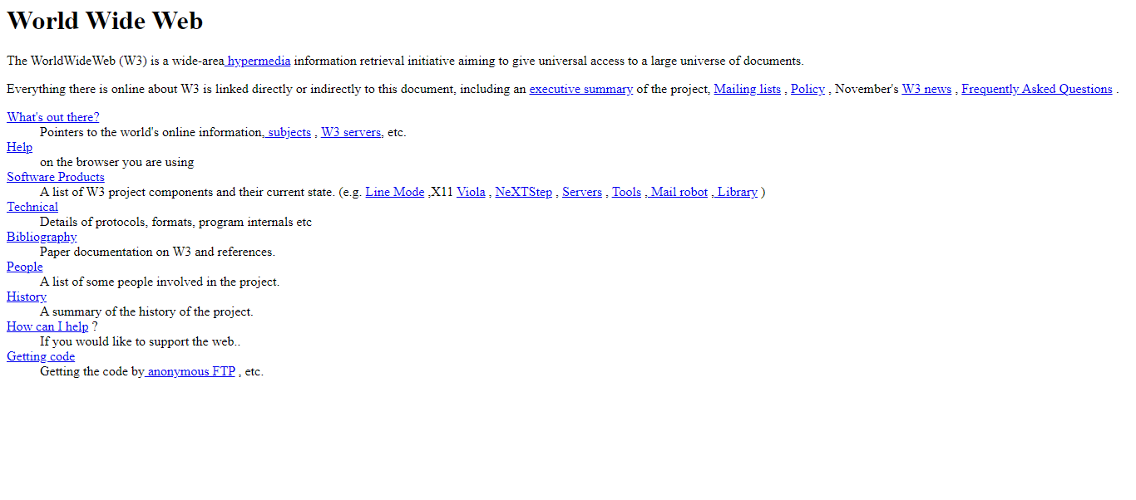

Slide 11
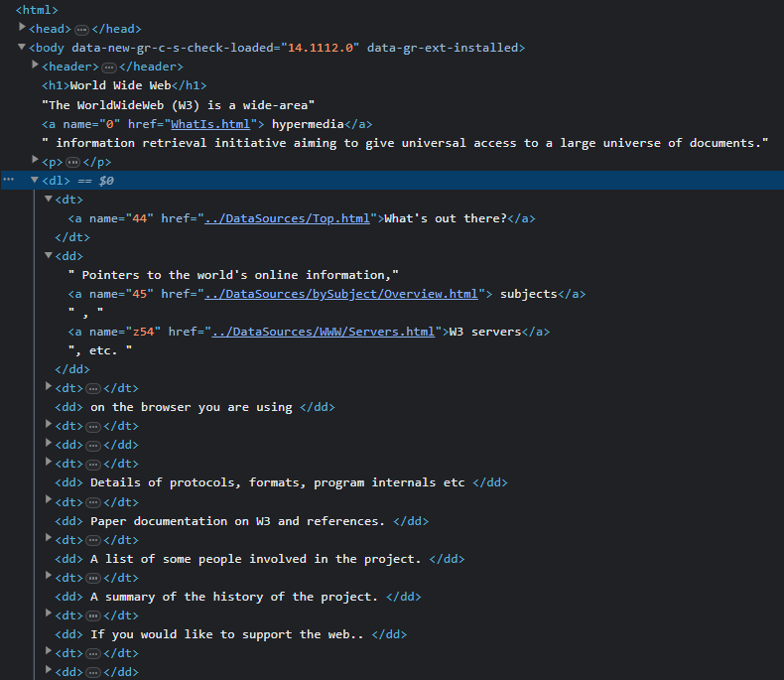

Slide 12
Key Components of the Web
Hypertext Transfer Protocol (HTTP) is the protocol used for transferring data on the Web.
Hypertext Markup Language (HTML) is the standard language for creating web pages.
Web browsers, such as Mosaic and later Netscape Navigator, played a crucial role in popularizing the Web.

Slide 13
Milestones in the Web's History
In 1991, the first web page was created, establishing the framework for linking and navigating between web documents.
The development of web standards and technologies, including Cascading Style Sheets (CSS) and JavaScript, enhanced the functionality and design of web pages.

Slide 14
Milestones in the Web's History
The emergence of search engines like Yahoo, AltaVista, and later Google revolutionized web search and made information more accessible.
The rise of social media platforms, such as Facebook and Twitter, transformed the Web into a dynamic, interactive space for communication and content sharing.

Slide 15
“Thank you”

